Slide 1
Computer Vision 2 COMPSCI 760 2024 Semester 1
Olivier Graffeuille ogra439@aucklanduni.ac.nz

Slide 2

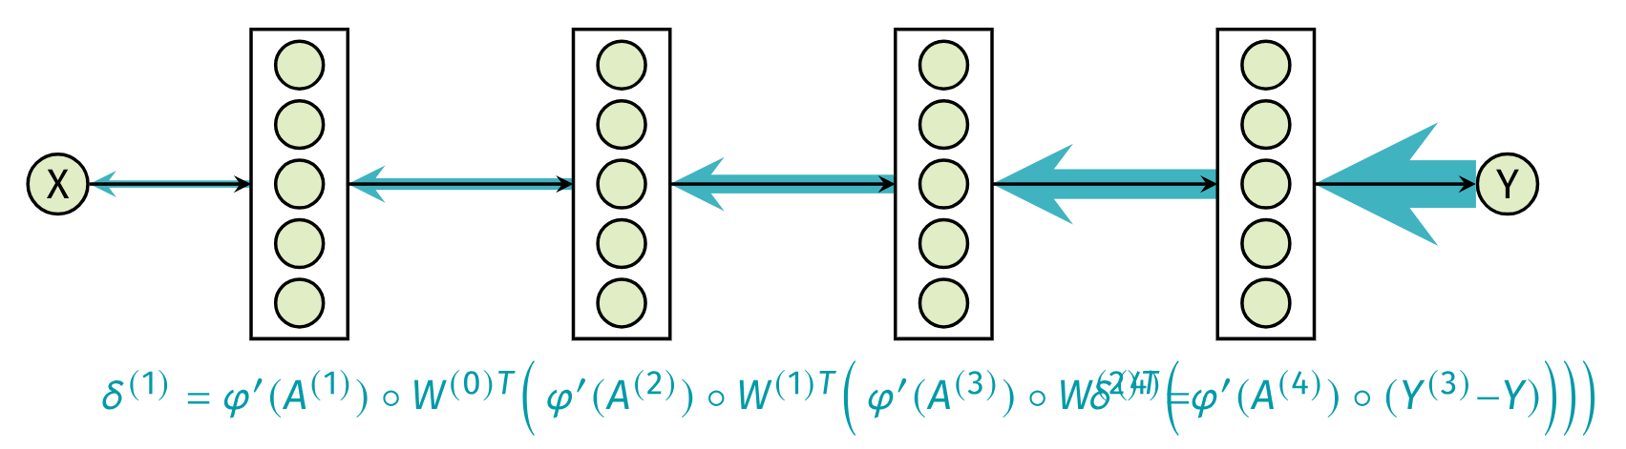
Clarifications from Last Lecture
Vanishing Gradients
A long sequence of mathematical operations is unstable

Slide 3
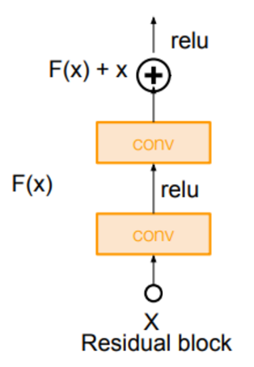
Clarifications from Last Lecture
Regular Deep Networks
Y
1
1x0.1
1x0.1x0.1

Slide 4
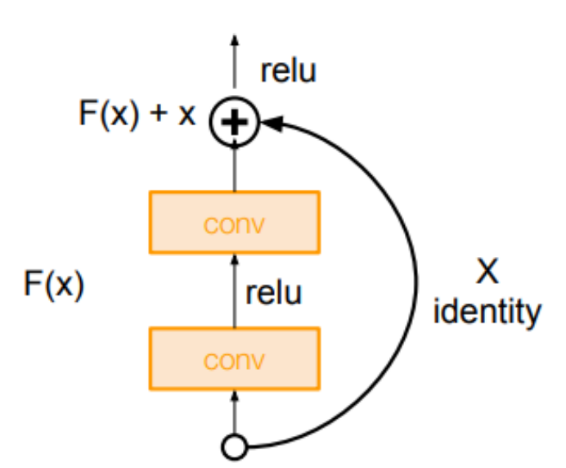
Clarifications from Last Lecture
Residual Networks
Y
1
Avoids vanishing gradients
1
1x0.1
1
1x0.1x0.1
1 + 1x0.1x0.1
X

Slide 5
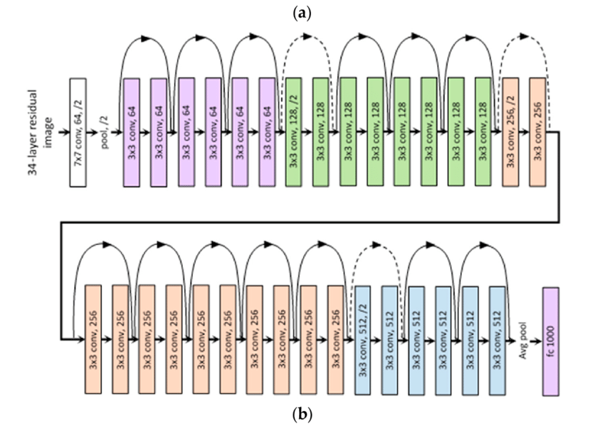
Clarifications from Last Lecture
ResNet (2015)
Adding new layers, at worst, is like adding the identity function (no change)
These new layers can learn a function which is better than the identity

Slide 6
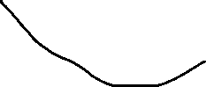
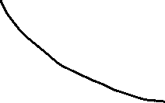
Clarifications from Last Lecture
Depth vs. Performance
Regular Network
Regular CNNs have enough capacity to learn accurate models
However, we aren’t able to train them accurately
Vanishing gradients
Identity function start
Error
Practice
Theory
Depth

Slide 7
Clarifications from Last Lecture
Vision Transformers vs. CNNs
CNNs
Requires large datasets
Similar to human vision
Vision transformers
Requires HUGE datasets
Very different from human vision
Useful for vision/language interaction (foundation VLMs)

Slide 8
Outline
Computer vision tasks
Classification, localisation, landmark detection
Object Detection
Sliding window method
Bounding box prediction (YOLO)
Anchor boxes
Putting it all together

Slide 9
Outline
Computer vision tasks
Classification, localisation, landmark detection
Object Detection
Sliding window method
Bounding box prediction (YOLO)
Anchor boxes
Putting it all together

Slide 10
Acknowledgement/Disclaimer
The following slides are taken from Andrew’s Ng Coursera Convolutional Neural Networks lectures, part of the Deep Learning Specialization.
The source of the slides comes from DeepLearning.AI
Copyright notice:
These slides are distributed under the Creative Commons License.
DeepLearning.AI makes these slides available for educational purposes. You may not use or distribute these slides for commercial purposes. You may make copies of these slides and use or distribute them for educational purposes as long as you cite DeepLearning.AI as the source of the slides.
For the rest of the details of the license, see:
https://creativecommons.org/licenses/by-sa/2.0/legalcode

Slide 11
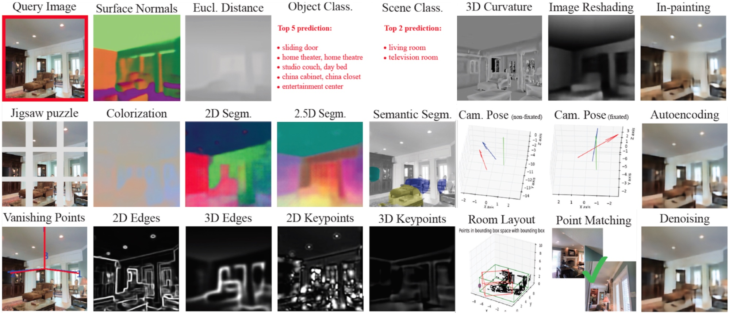
Computer Vision Tasks

Slide 12
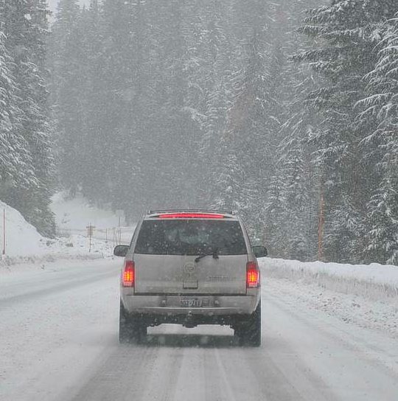
Computer Vision Tasks
Classification
Image classification
« Car »

Slide 13


Computer Vision Tasks
Classification
- pedestrian
- car
- motorcycle
- background
CONV
MAX POOL
FC
FC
FC
5 × 5 (× 3)
2 × 2 (× 16)
y
softmax (4)
14 × 14 × 3
10 × 10 × 16
5 × 5 × 16
400
400
Feature Extractor (Encoder)
Classifier (Decoder)

Slide 14
Computer Vision Tasks
Classification + Localisation
Image classification
Classification with localization
« Car »
« Car » + localisation (e.g., bounding box)

Slide 15
Computer Vision Tasks
Classification + Localisation
(0,0)
Softmax unit
(e.g., 2 if there is a car)
b_{w}
⋮
⋯
b_{h}
Bounding box
(b_{x,}, b_{y}, b_{h,}, b_{w})
(1,1)
CNN
b_{x,}, b_{y}
- pedestrian
- car
- motorcycle
- background

Slide 16
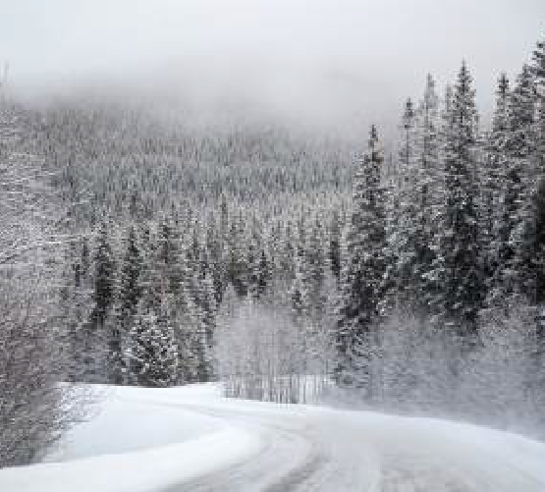
Computer Vision Tasks
Need to output b_{x}, b_{y}, b_{h}, b_{w}, class label (1-4)
- pedestrian
- car
- motorcycle
- background
Is there any object? (1 or 0 if none of the classes)
p_{c}
b_{x}
b_{y}
b_{h} b_{w}
c₁
c₂
c₃
1
0.5
0.7
0.3 0.4
0
1
0
0
?
?
?
?
?
?
?
If p_{c} = 1
Do not care
Bounding box coordinates
y =
Class
16

Slide 17
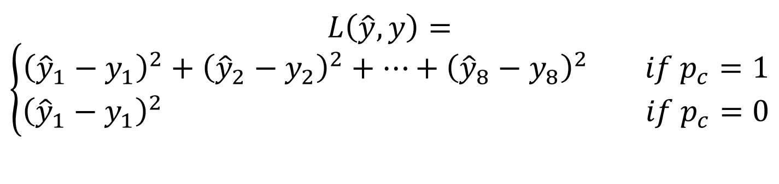
Computer Vision Tasks
Classification + Localisation
p_{c}
b_{x}
b_{y}
b_{h} b_{w}
c₁
c₂
c₃
$$L\left(\hat{y},y\right)=$$
$$\left\{\begin{aligned}{\left({\hat{y}}_{1}−y_{1}\right)}^{2}+{\left({\hat{y}}_{2}−y_{2}\right)}^{2}+…+{\left({\hat{y}}_{8}−y_{8}\right)}^{2} if p_{c}=1 \\ {\left({\hat{y}}_{1}−y_{1}\right)}^{2} if p_{c}=0\end{aligned}\right.$$
y =
17

Slide 18

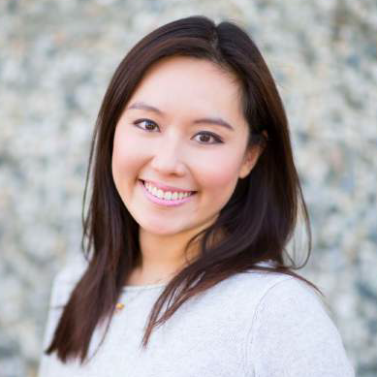
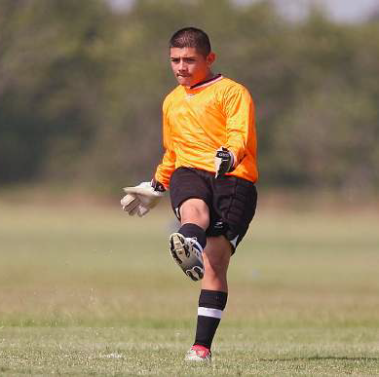
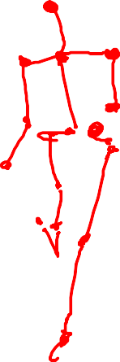
Computer Vision Tasks
Landmark
Detection
Is there a face?
l_{1x}
l_{1y}
…
l_{nx}
l_{ny}
ConvNet
2n + 1 units
X is the image.
Y is the vector of landmarks positions.
l_{1x}, l_{1y}
l_{2x}, l_{2y}
l_{1x}, l_{1y}
l_{2x}, l_{2y}
…
l_{nx}, l_{ny}
b_{x}, b_{y}, b_{h}, b_{w}
Can also be used for pose recognition.
18

Slide 19
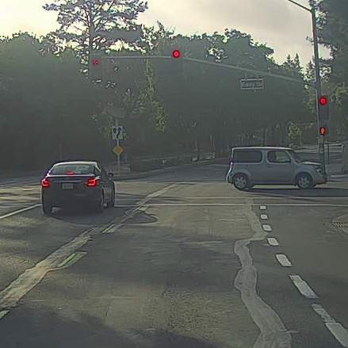
Computer Vision Tasks
Object Detection
Image classification
Classification with localization
Object Detection
« Car »
« Car » + localisation (e.g., bounding box)
Multiple objects + localisations (e.g., bounding boxes)
1 object

Slide 20
Outline
Computer vision tasks
Classification, localisation, landmark detection
Object Detection
Sliding window method
Bounding box prediction (YOLO)
Anchor boxes
Putting it all together

Slide 21
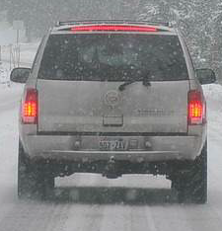
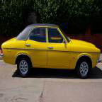
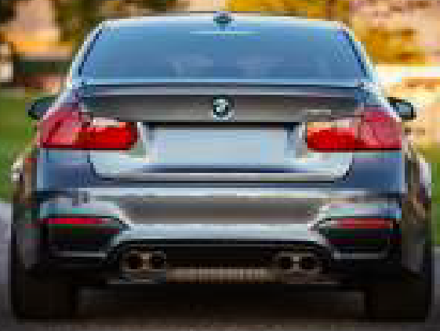
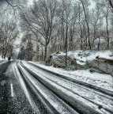

Object Detection
Can we just use classification?
Training set:
x
y
1
1
ConvNet
1
0
0
21

Slide 22
Object Detection
Sliding Window Method
What are the problems with this approach?
ConvNet
0
ConvNet
1
22

Slide 23
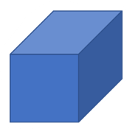

Object Detection
Linear Layers as Convolutions
MAX POOL
FC
FC
FC
CONV
5 × 5 (× 3)
2 × 2 (× 16)
y
softmax (4)
14 × 14 × 3
10 × 10 × 16
5 × 5 × 16
400
400
CONV
MAX POOL
CONV
CONV
CONV
5 × 5 (× 3)
2 × 2 (× 16)
5 × 5 (× 16)
1 × 1 (× 400)
1 × 1 (× 4)
14 × 14 × 3
10 × 10 × 16
5 × 5 × 16
1 × 1 × 400
1 × 1 × 400
1 × 1 × 4
400 filters
400 filters
23
4 filters

Slide 24
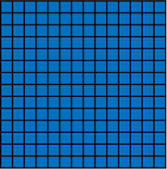
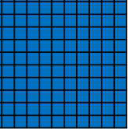
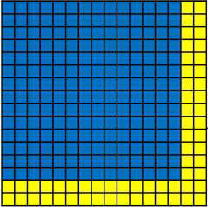
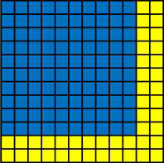



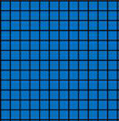
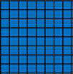
Convolution implementation of sliding windows
MAX POOL CONV
2×2 5×5
CONV
CONV
Input (cropped image)
5×5
1×1
1×1
14×14 ×3
10×10×16
5×5×16
1×1×400
1×1×400
1×1×4
MAX POOL
CONV
CONV
CONV
Test image
5×5
2×2
5×5
1×1
1×1
16×16×3
12×12×16
6×6×16
2×2×400
2×2×400
2×2×4
MAX POOL
2×2
5×5
5×5
1×1
1×1
28×28×3 24×24×16 12×12×16 8×8×400 8×8×400
8×8×4
[Sermanet et al., 2014, OverFeat: Integrated recognition, localization and detection using convolutional networks]

Slide 25
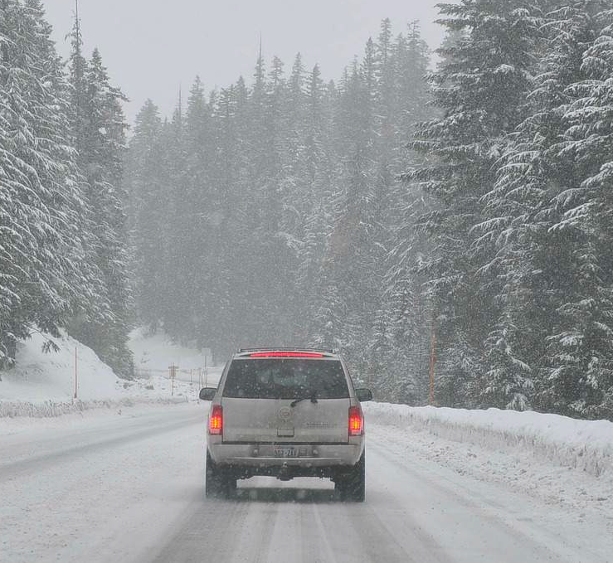
Convolution implementation of sliding windows

Slide 26
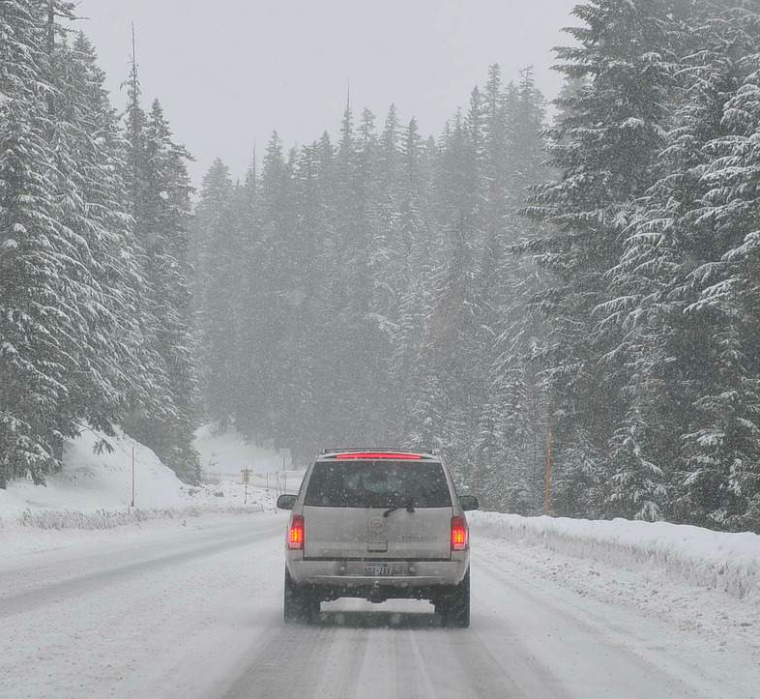
Problem: Inaccurate estimation

Slide 27
Outline
Computer vision tasks
Classification, localisation, landmark detection
Object Detection
Sliding window method
Bounding box prediction (YOLO)
Anchor boxes
Putting it all together

Slide 28

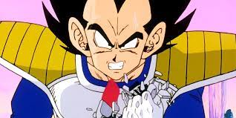
YOLO: You Only Look Once
YOLO: You Only Look Once (2015)
This paper revolutionised object detection
What do these two images have in common?
28
[Redmon et al., 2015, You Only Look Once: Unified real-time object detection]

Slide 29
YOLO: You Only Look Once
Labels for training For each grid cell:
What size is the output?
p_{c}
b_{x}
b_{y}
b_{h} b_{w}
c₁
c₂
c₃
0
?
?
?
?
?
?
?
1
b_{x}
b_{y}
b_{h} b_{w}
0
1
0
1
b_{x}
b_{y}
b_{h} b_{w}
0
1
0
Target output:
3×3×8
100
y =
100
x
100 × 100 × 3
ConvNet
y
3 × 3 × 8
29
[Redmon et al., 2015, You Only Look Once: Unified real-time object detection]

Slide 30
YOLO: You Only Look Once
Bounding Boxes for Object Detection
1
b_{x}
b_{y}
b_{h} b_{w}
0
1
0
(0,0)
x position of middle of bb to cell (0,0) = 0.4
Between 0 and 1
y position of middle of bb to cell (0,0) = 0.3
100
heigth of bb as a fraction of cell size = 0.5
Can be > 1
width of bb as a fraction of cell size = 0.9
(1,1)
30
[Redmon et al., 2015, You Only Look Once: Unified real-time object detection]

Slide 31
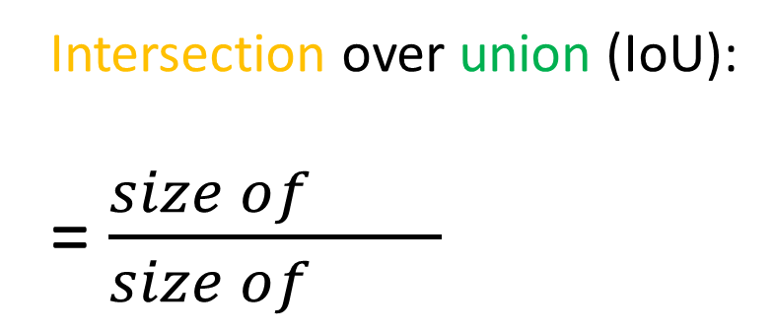
YOLO: You Only Look Once
Bounding Boxes: Evaluation
Intersection over union (IoU):
= $\frac{size of }{size of }$
“Correct” if IoU ≥ 0.5
More generally, IoU is a measure of the overlap between two bounding boxes.
31
[Redmon et al., 2015, You Only Look Once: Unified real-time object detection]

Slide 32
YOLO: You Only Look Once
Bounding Boxes: Duplicates
32

Slide 33
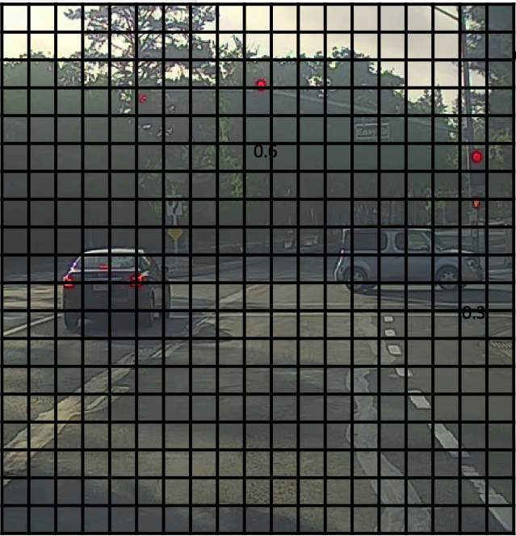
YOLO: You Only Look Once
Bounding Boxes: Duplicates
0.6
0.8
0.9
0.3
0.5
19 × 19
33

Slide 34
YOLO: You Only Look Once
p _{c} b_{x}
b_{y}
b_{h} b_{w}
Non-max suppression example
Non-Max Suppression
Each output prediction is:
Discard all boxes with p _{c} ≤ 0.6
While there are any remaining boxes:
Pick the box with the largest p_{c.} Output that as a prediction.
Discard any remaining box with IoU ≥ 0.5 with the box output in the previous step.
0.6
0.8
0.9
0.7
0.7
34

Slide 35
Outline
Computer vision tasks
Classification, localisation, landmark detection
Object Detection
Sliding window method
Bounding box prediction (YOLO)
Anchor boxes
Putting it all together

Slide 36
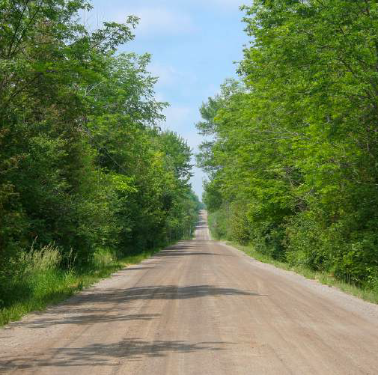
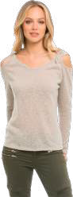
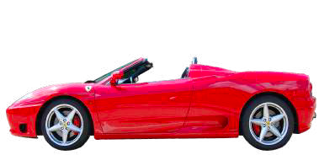
YOLO: You Only Look Once
Non-max suppression example
Anchor Box Method
Anchor box 1:
p_{c}
b_{x}
b_{y}
b_{h} b_{w}
c₁
c₂
c₃
p_{c}
b_{x}
b_{y}
b_{h} b_{w}
c₁
c₂
c₃
Anchor box 1
(more similar to pedestrian’s shape)
p_{c}
b_{x}
b_{y}
b_{h} b_{w}
c₁
c₂
c₃
y =
Anchor box 2:
y =
Anchor box 2
(more similar to car’s shape)
36
36

Slide 37
YOLO: You Only Look Once
Car only?
Non-max suppression example
Anchor Box: Example
p_{c}
b_{x}
b_{y}
b_{h} b_{w}
c₁
c₂
c₃ p_{c}
b_{x}
b_{y}
b_{h} b_{w}
c₁
c₂
c₃
1
b_{x}
b_{y}
b_{h} b_{w}
1
0
0 1
b_{x}
b_{y}
b_{h} b_{w}
0
1
0
0
?
?
?
?
?
?
? 1
b_{x}
b_{y}
b_{h} b_{w}
0
1
0
Anchor
box 1
y =
Anchor box 1
Anchor box 2
Anchor
box 2
37

Slide 38
YOLO: You Only Look Once
Non-max suppression example
Anchor Box Method
With two anchor boxes:
Each object in training image is assigned to grid a cell that contains that object’s midpoint, and anchor box for the grid cell with highest IoU.
Output (for each grid cell, 3 classes, and 2 anchor boxes)
y: 3×3×16 (3×3×2×8)
Previously:
Each object in training image is assigned to a grid cell that contains that object’s midpoint.
Output (for each grid cell and 3 classes)
y: 3×3×8
38

Slide 39
YOLO: You Only Look Once
Non-max suppression example
Anchor Box Method
Can detect multiple objects within a cell, but:
Only one object related to each anchor box per cell (usually enough)
Allows the network to specialise into different object types
39

Slide 40
Outline
Computer vision tasks
Classification, localisation, landmark detection
Object Detection
Sliding window method
Bounding box prediction (YOLO)
Anchor boxes
Putting it all together

Slide 41
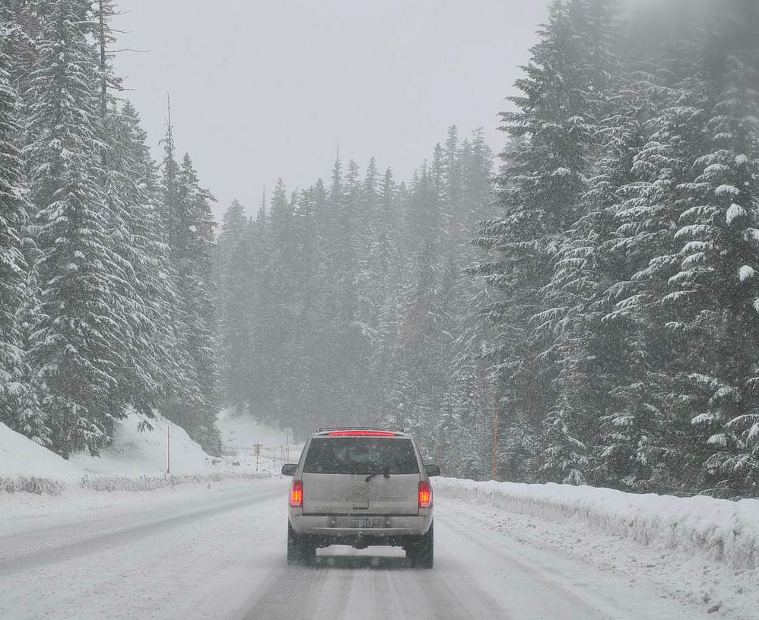
YOLO: You Only Look Once
p_{c}
b_{x}
b_{y}
b_{h} b_{w}
c₁
c₂
c₃ p_{c}
b_{x}
b_{y}
b_{h} b_{w}
c₁
c₂
c₃
0
?
?
?
?
?
?
? 0
?
?
?
?
?
?
?
0
?
?
?
?
?
?
? 1
b_{x}
b_{y}
b_{h} b_{w}
0
1
0
Non-max suppression example
Training YOLO
y
=
Anchor
box 2
(bounding box for car is a bit wider than higher)
Anchor
box 1
3×3×16
Anchor
box 2
y is 3×3×2×8
5 + 3 classes
ConvNet
y
3 × 3 × 16
x
100 × 100 × 3
# anchor boxes

Slide 42
YOLO: You Only Look Once
Predicting with YOLO
Non-max suppression example
Making predictions
p_{c}
b_{x}
b_{y}
b_{h} b_{w}
c₁
c₂
c₃ p_{c}
b_{x}
b_{y}
b_{h} b_{w}
c₁
c₂
c₃
0
…
…
…
…
…
…
… 0
…
…
…
…
…
…
…
0
…
…
…
…
…
…
…
1
b_{x}
b_{y}
b_{h} b_{w}
0
1
0
⋯
y =
3×3×2×8
42

Slide 43
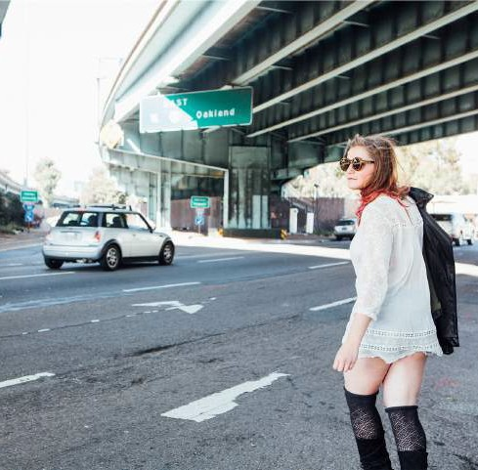
YOLO: You Only Look Once
Non-max suppression example
Predicting with YOLO: Non-Max Suppression
For each grid call, get 2 predicted bounding boxes.
Get rid of low probability predictions.
For each class (pedestrian, car, motorcycle) independently run non-max suppression to generate final predictions.
43

Slide 44
YOLO: You Only Look Once
Non-max suppression example
YOLO Summary
Object detection by estimating object position in a grid of cells
Convolutional implementation for computational speed
Anchor boxes to predict multiple objects per cell
Non-max suppression to remove duplicate predictions
44

Slide 45
YOLO: You Only Look Once
Non-max suppression example
YOLO Versions
YOLOv1: Introduced a novel real-time object detection system that predicts bounding boxes and class probabilities directly from full images in one evaluation, significantly speeding up detection speeds.
YOLOv2: Improved accuracy with anchor boxes, finer-grained features using a passthrough layer from earlier layers, and the ability to detect over 9000 object categories using a joint training method on both ImageNet and COCO datasets.
YOLOv3: Enhanced detection at various scales by incorporating three different scales for prediction, and used a deeper network backbone (Darknet-53) for improved feature extraction.
YOLOv4: Boosted accuracy and efficiency by integrating advanced techniques such as Mish activation, Cross-Stage Partial connections, and Self-Adversarial Training, while still maintaining real-time performance.
YOLOv8…
45

Slide 46
YOLO: You Only Look Once
Non-max suppression example
An interesting history
The main author, Joseph Redmon, was a computer vision PhD student
The first paper’s name “YOLO” is a reference to a meme at the time
The second paper was called “YOLO9000” and promised to predict “over 9000” classes, a reference to dragon ball Z
46

Slide 47

YOLO: You Only Look Once
Non-max suppression example
An interesting history
Joseph stopped working on computer vision for ethical reasons, e.g. military drones
47

